Slide 1
Industrial Heat Pumps
An EPRI Perspective
Ammi Amarnath
Principal Technical Executive
Utility Energy Forum
Cambria, April 2025

Slide 2

EPRI’s Vision
To be a world leader in advancing
science and technology solutions
for a clean energy future
EPRI’s Mission
Advancing safe, reliable, affordable, and
clean energy for society through global collaboration, science and technology innovation, and applied research.
Together…Shaping the Future of Energy®

Slide 3

Three Key Aspects of EPRI
Collaborative
Bring together scientists, engineers, academic researchers, and industry experts
Independent
Objective, scientifically based results address reliability, efficiency, affordability, health, safety, and the environment
Nonprofit
Chartered to serve the public benefit

Slide 4
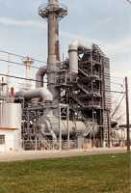
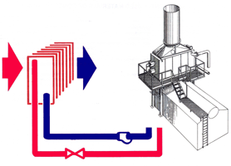
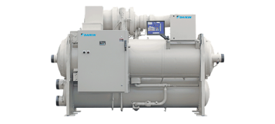
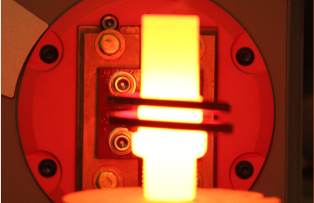

Opportunities for Decarbonization in Industry
Efficiency, Electrification, Low Carbon Fuels, & Carbon Capture in Process Heating
Process Integration
  Pinch Technology
Waste Heat Recovery and Reuse
  Industrial Heat Pumps
Electric-Driven Process Heating
  MW, RF, IR, Acoustic, Ohmic etc.
Low Carbon Fuels
  Hydrogen, Ammonia etc.
Carbon Capture & Utilization
  Storage, Chemical Synthesis etc.
Heat Recovery HP/Chiller
4
www.epri.com

Slide 5
Pinch Analysis – Efficiency is the Lowest Hanging Fruit!
Minimize heat loss by thermal energy optimization technique
Matching hot streams with cold streams via optimum heat recovery
Minimize reliance on external energy inputs
Pinch temperature (where heating and cooling curves come close together) defines an industrial site’s unique heat distribution
Pinch Analysis also provides amount of waste heat that can be recovered by Industrial Heat Pumps
Source: EPRI Report CU-6775
EPRI and US DOE Championed “Pinch Technology” in 1990s

Slide 6
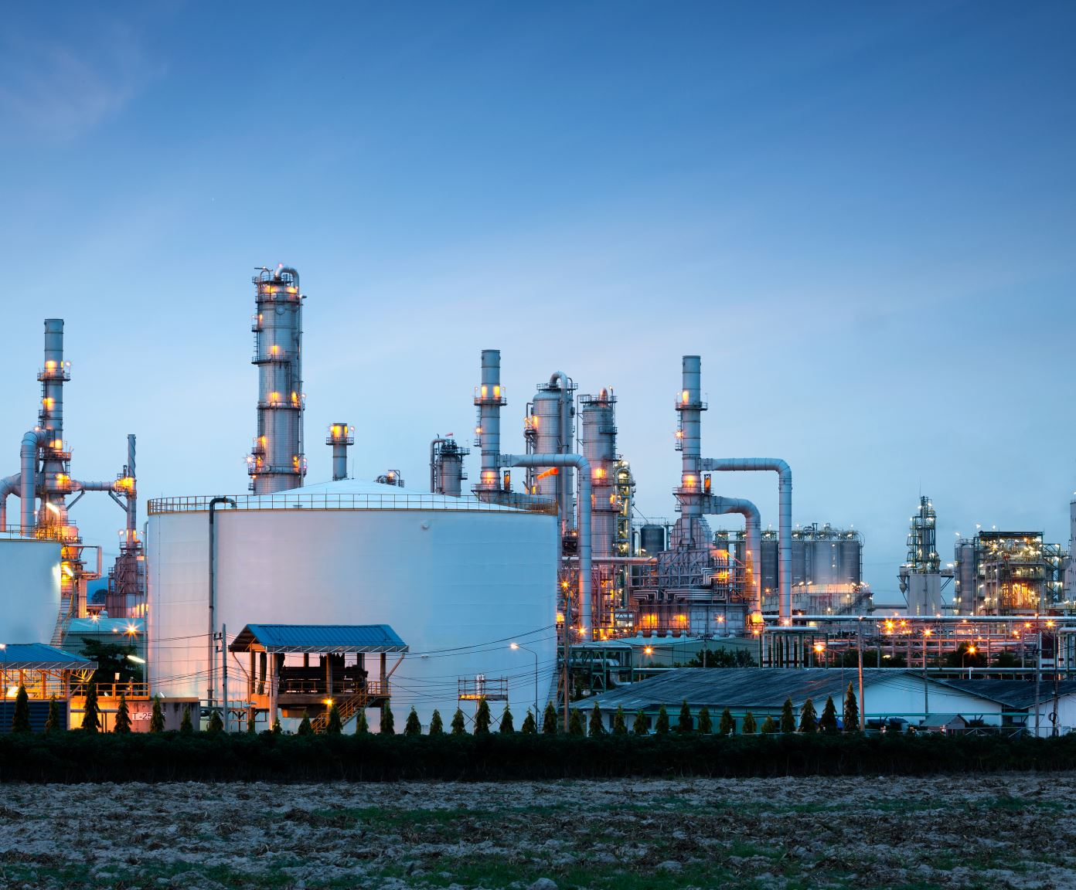
Opportunities to Use Low Temperature Industrial Waste Heat
Low-temperature waste heat streams available abundantly in industries
Typical waste heat are at temperatures in the 70-80ºC range
Sources of waste heat: chillers, cooling processes, return steam condensate going to drainage
Many industries needs low-pressure steam in 120-150ºC range
Industry applications: food manufacturing (e.g., bakeries, dairy etc.), paper, chemical, and textiles

Slide 7
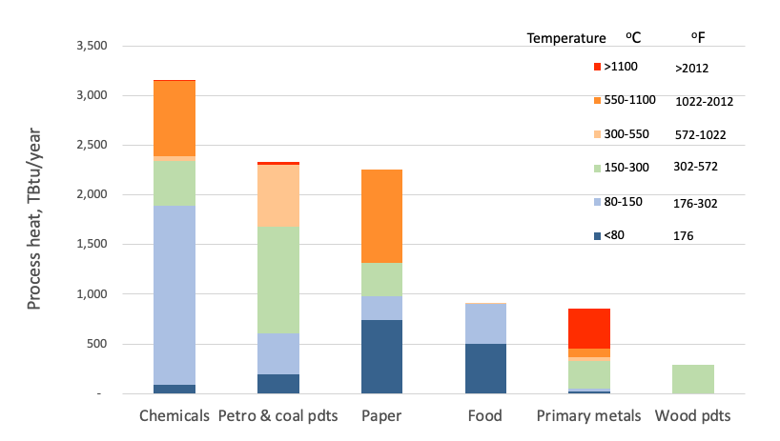
Significant Industrial Process Heat is Below 150 ⁰C
Data Source: McMillan 2019

Slide 8
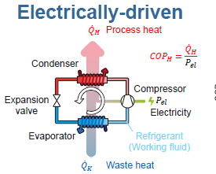
Industrial Heat Pumps
Are electrically driven devices that efficiently provide high temperature water and steam for industrial processes
Environmentally friendly alternative to traditional heating systems
Safer than combustion-based heating
Source: Arpagaus, C. et al., Potential Impact of Industrial HTHPs on the European Market
IEA Estimates 500 MW IHPs Needed per Month for Next 30 Years!

Slide 9
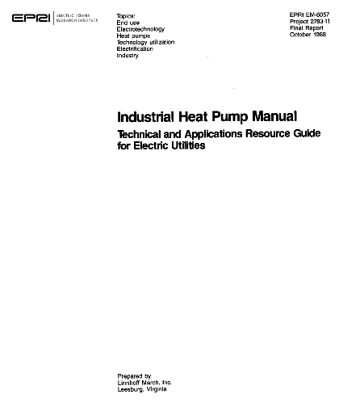
EPRI’s History in Industrial Heat Pump Space

Slide 10
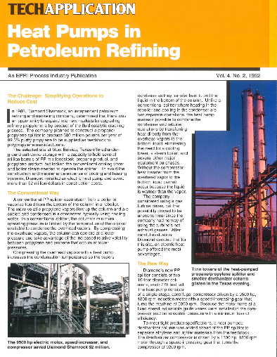
EPRI’s History in Industrial Heat Pumps (Continued)
Documented in early 1990s

Slide 11





























Players in the Industrial Heat Pumps Space (1 of 3)
Source: Danish Technological Institute

Slide 12
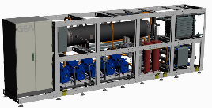
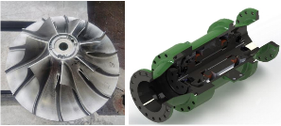
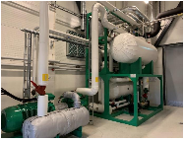
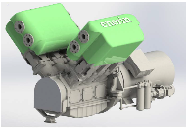
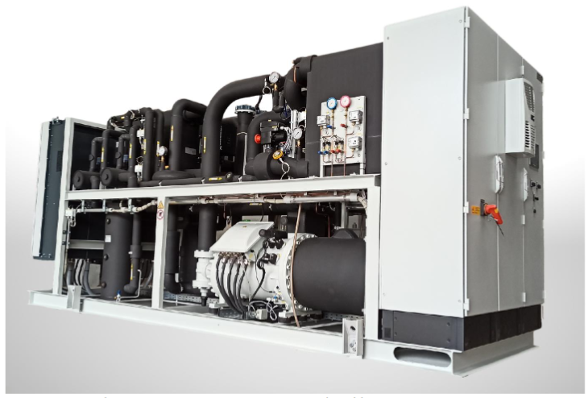
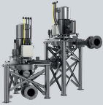
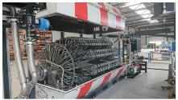
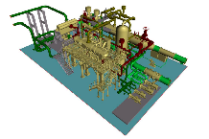
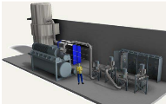
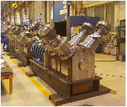
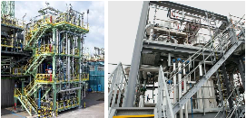
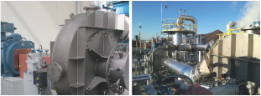
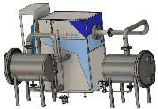
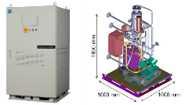
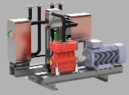
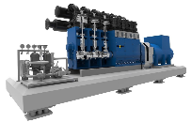

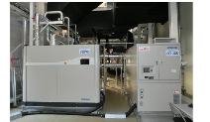
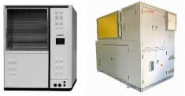
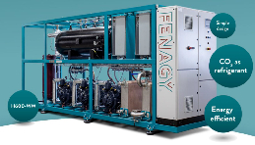
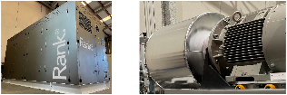
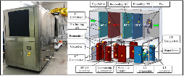
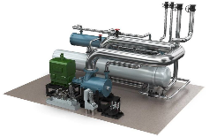
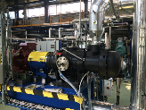
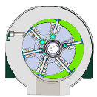
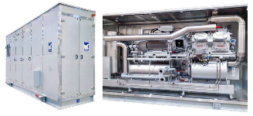
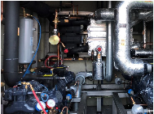
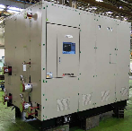
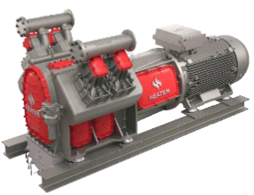
Players in the Industrial Heat Pumps Space (2 of 3)
Wide Applications in the Industry…
Source: Danish Technological Institute

Slide 13
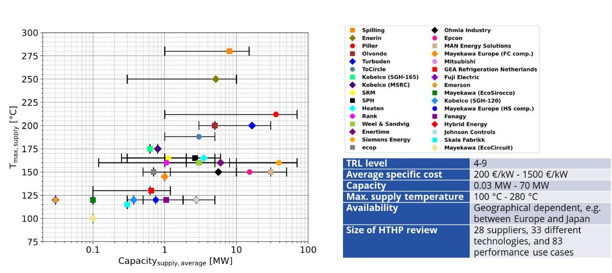
Players in the Industrial Heat Pumps Space (3 of 3)
Source: Danish Technological Institute

Slide 14
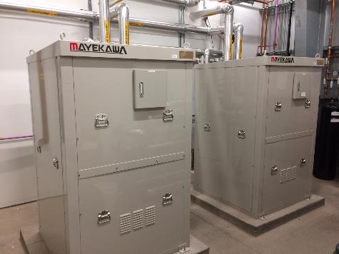

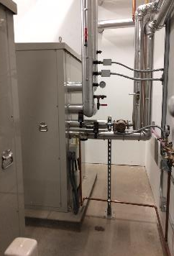

Some Industrial HP Successes in the U.S. (<100 ⁰C)
High End Cabernet Estate Winery Facility located in Alexander Valley California
First New Commercial Winery in the World to Achieve LEED Platinum Certification!
Water Source CO₂ Heat Pumps provide Hot Water for Winery DHW/Tank/Barrel Cleaning
and Chilled Glycol for Barrel Room and Tank Cooling
(2) UNIMO ww units installed in Mechanical Room
Unit piping
Courtesy of Mayekawa MYCOM

Slide 15
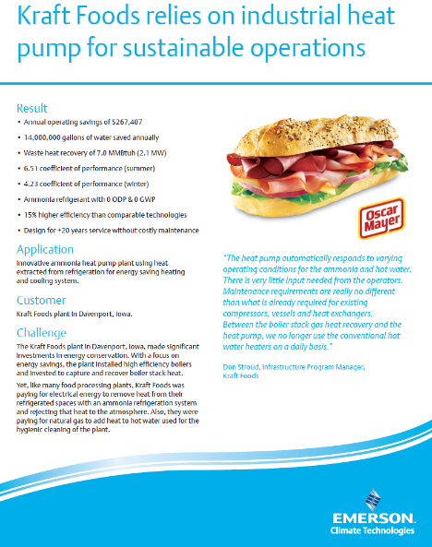
Other Installations in the U.S. (<100 ⁰C)
Ref – AMI Foundation Conference 2012
Ref – Emerson Website

Slide 16
EPRI Project: Low-Cost Steam Generating High Temp Heat Pump
Key characteristics of the heat pump:
  30 kW prototype system
  Low ODP, GWP refrigerant
  Develop prototype system produce steam at 120ºC from waste heat (80ºC) @ COP of 3.4
  Test in a lab in California; make it ready for field deployment
  Offer low-cost solutions for industry al decarbonization in California and around the country
Project funded by California Energy Commission

Slide 17
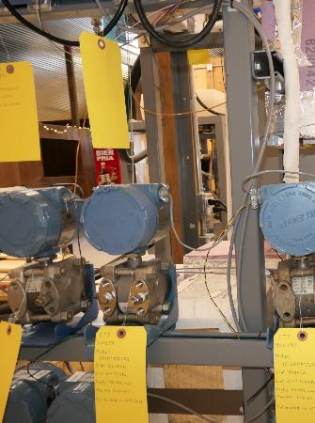
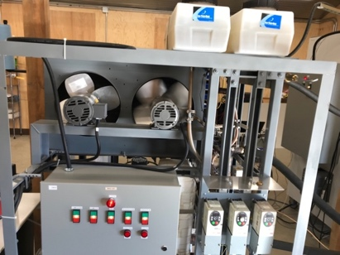
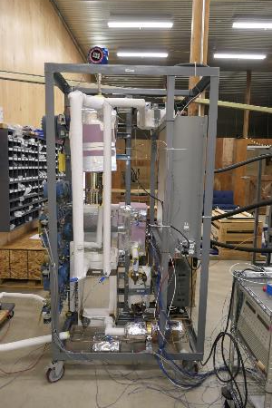
Photos of the 30 kW Prototype System
HP Prototype System
Prototype Showing Monitoring Instrumentation
Prototype Showing Controllers and ASDs

Slide 18
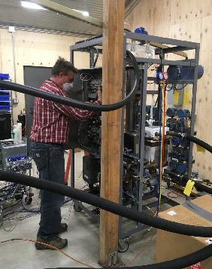
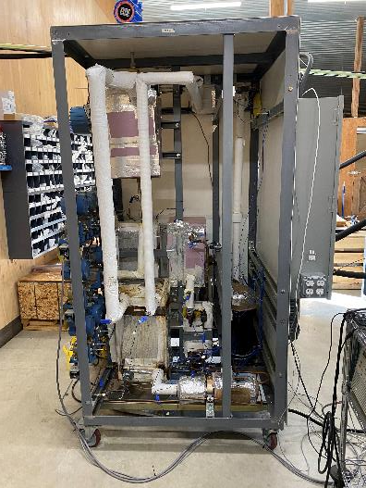
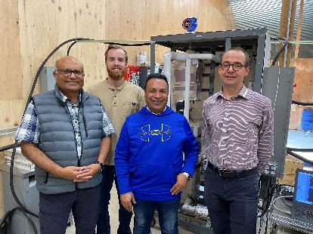
Photos of Breadboard and Prototype System

Slide 19
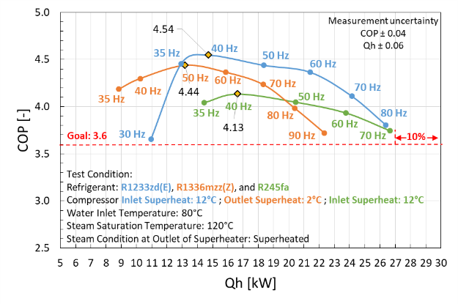
Prototype System Test Results
Key findings from the tests:
Coefficient of Performance (COP) has an inverse relation with system speed, a direct indicator of system load
Higher load (capacity) or compressor speed results in lower COP values
Two refrigerants performed the best
  R1233zd[E]: Higher COP, but has ODP
  R1336mzz[Z]: Lower COP, no ODP
  System should be optimized to obtain the target COP of 3.4 or greater
R1233zd(E)
Next Steps – Field Tests

Slide 20
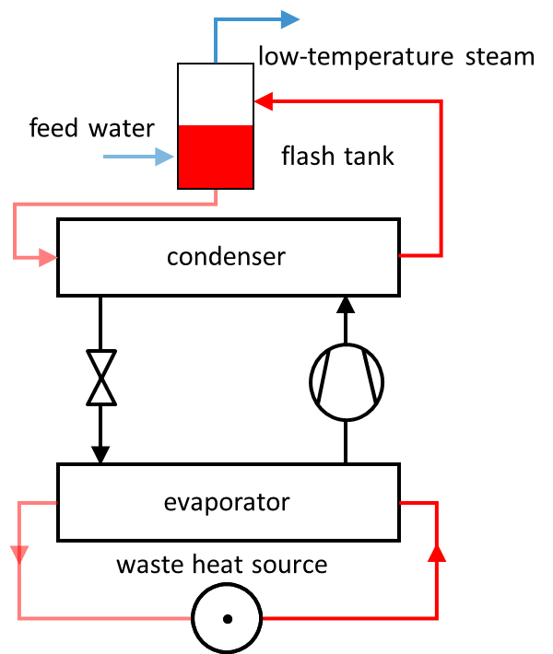
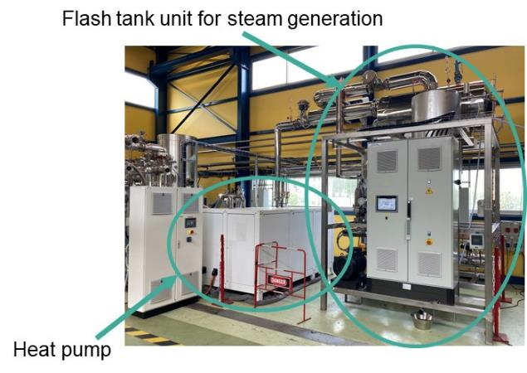
Europe’s Bamboo Project – Demo at Arcelor Mittal
Photo – EDF, AIT

Slide 21

Global IHP Market Size
HTHP is poised to grow at a CAGR of 5.4% from 2023 to 2032

Slide 22
HTHP Developments….Global Snapshot
Project | Country | Refrigerant | Heat Source (°C) | Heat Sink (°C) | Heating Capacity (kW)
Austrian Institute of Technology, Vienna, Chemours, Bitzer | Austria | R1336mzz(Z) | 30 to 100°C | 70 to 160°C | 12
PACO, University of Lyon, EDF | France | R718 | 70 to 90°C | 120 to 140°C | 300
EDF, Johnson Controls, Alter ECO | France | R245fa | 20 to 60°C | 90 to 140°C | 20 to 1,200
Tokyo Electric Power Company, Japan | Japan | R601 | 40 to 90°C | 95 to 135°C | 150 to 400
Austria: TU GAZ The Netherlands: ECN, SmurfitKappa, IBK, Bronswerk. | Austria Netherlands | R600 | 50 to 80°C | 80 to 125°C | 20 to 160
Turboden (MHI) Ori Martin Steelworks | Italy | R1233zd | 75°C | 120°C | 6,000
Note: This is a partial list

Slide 23
HTHP Developments….USA Snapshot
Project | Country | Refrigerant | Heat Source (°C) | Heat Sink (°C) | Heating Capacity (kW)
AtmosZero | USA | Not known | Atmosphere | 200°C | Not known
Armstrong International | USA | R1233zd | 70 to 80°C | 120°C | Not known
Siemens | Germany, USA | R1233zd, Other | Waste heat | 90 to 140°C | >10 MW
Oilon | Finland, USA | R1233zd | 60 to 90°C | 95 to 135°C | 30-450 kW
Thar Energy | USA | CO₂ | Waste heat | 80 to 130°C | Development
Skyven | USA | Water | 26 to 32°C | Up to 215°C | Upto 73 MW (Development)
Note: This is a partial list

Slide 24
Barriers for Industrial Heat Pump Adoption in USA
Product Availability and Economics
Overcoming Safety Concerns
Well-Documented Performance History
Sales and Service Support

Slide 25
Overcoming Market Barriers
Addressing upfront costs
Increasing awareness and education
Developing financing options
Provide ongoing support

Slide 26
Government Grants for Industrial Heat Pumps - Examples
Industrial Efficiency and Decarbonization FOA 2804
Award Amount: $20.4 million
Industrial Efficiency and Decarbonization FOA 3206
Commercializing Industrial Decarbonization
Award amount: $38 million
INDIGO¹ grants – $46 million
¹Industrial Decarbonization and Improvement of Grid Operations

Slide 27
Heat Pumps and the Grid – A Consideration
Top barriers to Heat Pumps at scale that must be addressed:
Some Enabling Actions
Ensure utilities (and regulators) are in lock-step with technology developers, OEMs, and consumers
  Power availability
  Power reliability
  Grid interconnections
  Grid readiness
Optimize systems and processes that support the pace of activity/investment required
Develop needed tools and technologies that enable HP scale and (perhaps) capture the grid benefits of HPs
Customers and Utilities Need to Work Together!

Slide 28


Summary of Needs
Document Status of Current Applications
Focus on Technology Development
Apply Technology to Several Applications
Conduct Case Studies and Technology Transfer
Government and Utility Incentives
Collaboration between all Stakeholders

Slide 29

Questions?
This Photo by Unknown Author is licensed under CC BY-ND

Slide 30
Thank You!
Ammi Amarnath
Principal Technical Executive
aamarnath@epri.com
+1 (650) 855-1007

